Slide 1
Sprint 2 Demo
Tuesday, May 17th, 2022

Slide 2
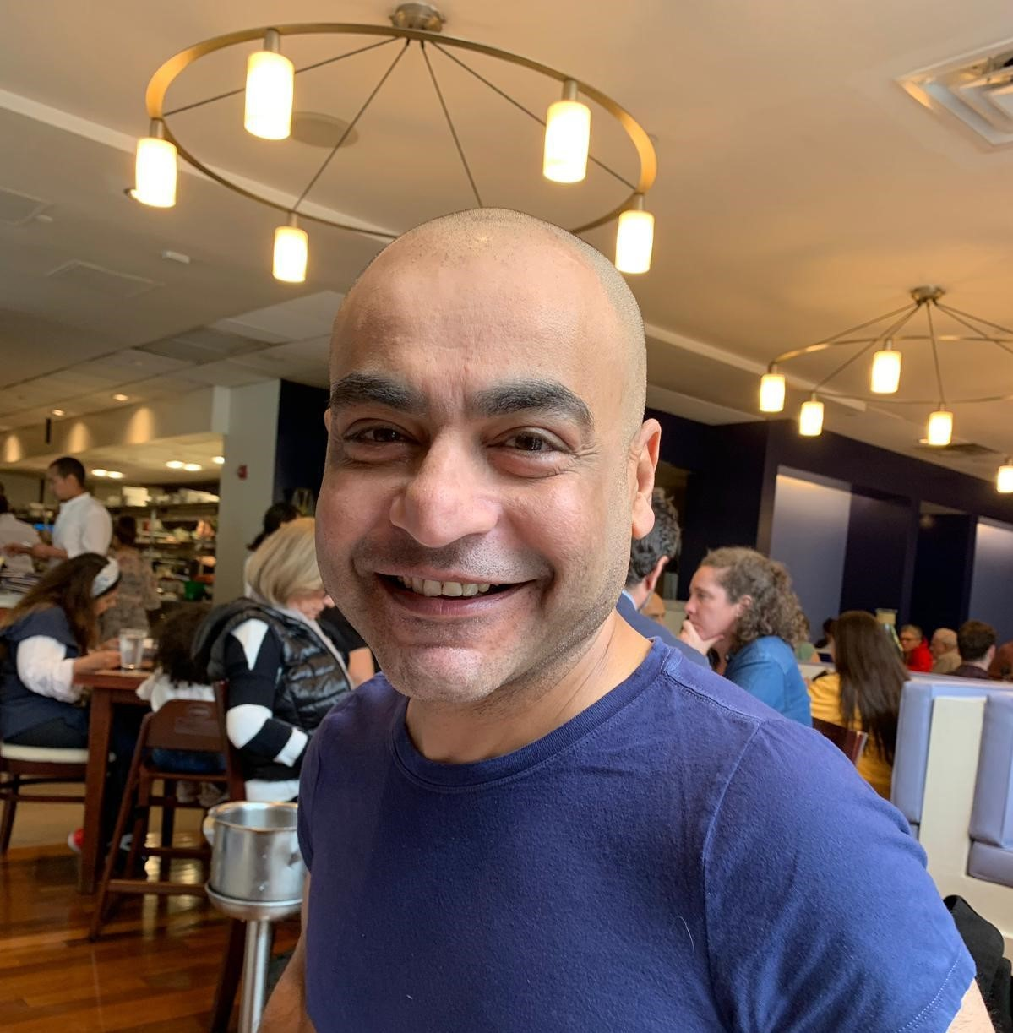

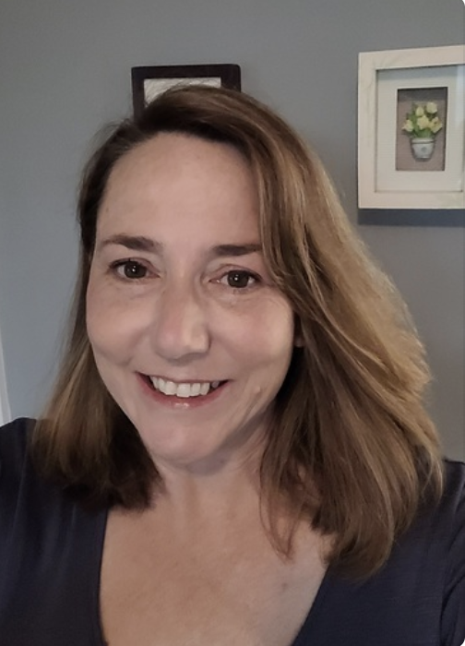
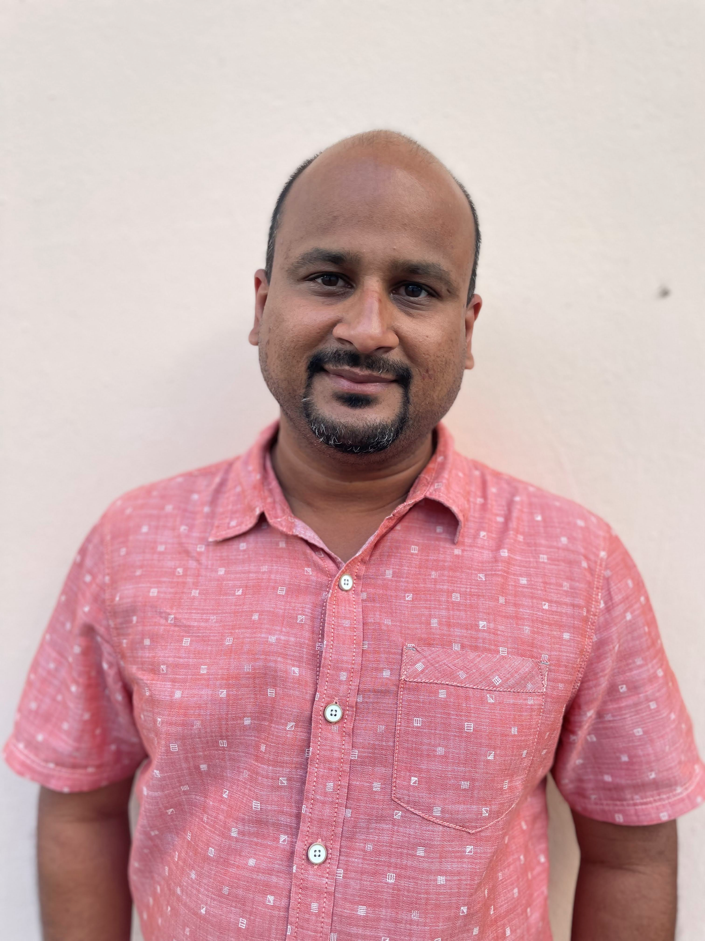








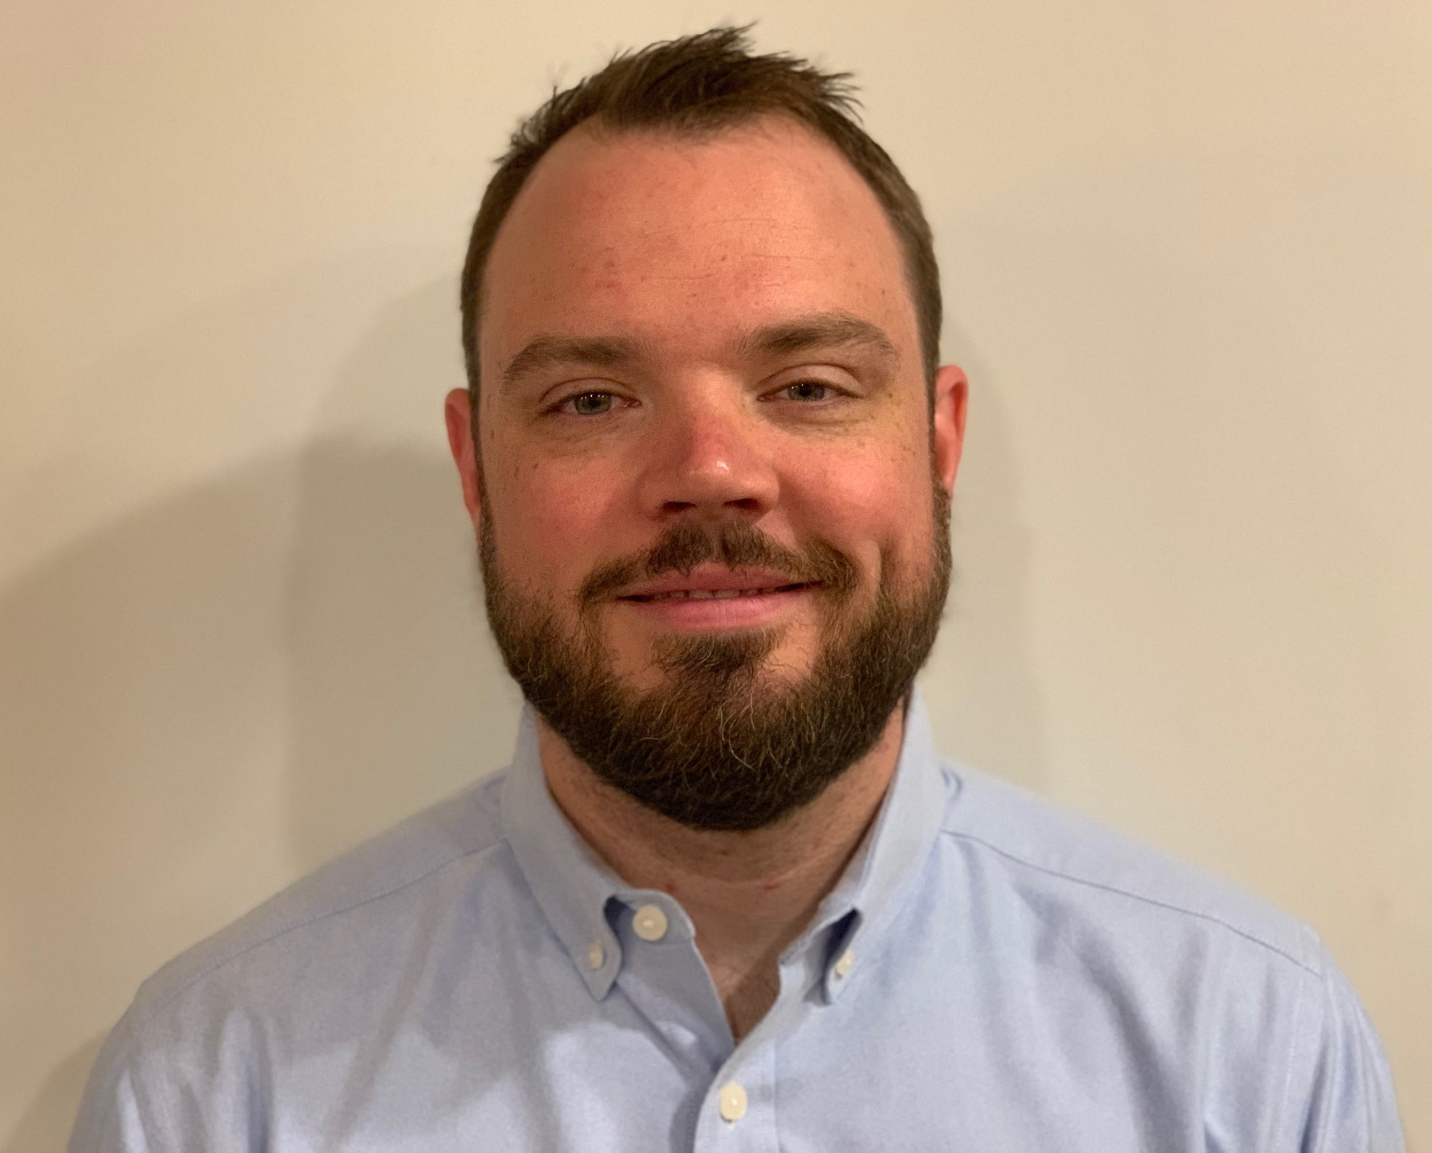
Get to know the team
Core team
Executive team
PRODUCT
ENGINEERING
Munish Sikka
Washington DC
Product Lead
Jordan White Dallas, TX Product Manager
Tami Corson
North Carolina
Clinical SME / Scrum
Shashank Khandelwal
Rockville, MD
Tech Lead
Jeff Scheire
MO Studio
Marcy Jacobs
McKinsey & Co
Kevin London Frog Design
DESIGN
Thomas McCue Oak Park, IL Principal Designer Director
Carl Dickerson Atlanta, GA Content Strategist and Plain Language Content Creator
Carolyn Williams Chicago, IL Experience Designer
Will Reynolds SERVE Advisory
Ben Morris
Pluribus Digital
Travis Hoffmann
MO Studio
05-17 Sprint 2 Demo
Introduction

Slide 3



At the end of each sprint on Tuesdays, the team will run sprint reviews to showcase the sprint’s work for approval. The purpose of this meeting is:
WELCOME TO THE SPRINT 1 DEMO
1
To demo the accomplishments or functionality that was built over the past sprint
2
To get feedback and insights early and often
3
To create transparency for anyone interested on the product and progress
05-17 Sprint 2 Demo
Introduction

Slide 4
CEDAR TO1 Overview
WE ARE HERE
PHASE
CY 2021
CY 2022
SPRINT
0
1
2
3
4
5
6
7
8
9
10
11
12
13
14
15
16
17
18
19
20
21
22
23
24
25
26
27
MONTH
Sep
Oct
Nov
Dec
Jan
Feb
Mar
Apr
May
Jun
Jul
Aug
Sep
DHM - Health Apartment
FOCUS
1095-B Form
Follow ups as needed
Community Care
Health Hub
05-17 Sprint 2 Demo
Introduction

Slide 5
Agenda
Sprint Goal:
For sprint 2 we focused on structuring our IA tree tests, continuing and synthesizing our findings from business partner interviews, and thinking about future research activities
HEALTH HUB
Draft of research activities plan
Business partner discovery and synthesis
Experience map skeleton
Draft research plan for IA Tree Test
1095-B
Updates on 1095-B
 | We welcome all feedback! Feedback will be collectively reviewed and prioritized appropriately based on where it stacks against other stories in the backlog as well as technical feasibility.
05-17 Sprint 2 Demo
Agenda

Slide 6
Health Hub
SPRINT 2 DEMO
05-17 Sprint 2 Demo

Slide 7
Health Hub Strategic Roadmap v1
WE ARE HERE
YEAR
CY 2022
Option YR
MONTH
Apr
May
Jun
Jul
Aug
Sep
SPRINT
Task Order
16
17
18
19
20
21
22
23
24
25
Product
1
2
3
4
5
6
7
8
9
10
FOCUS
Product Strategy
& Planning
Comparative
Research
Research
Design
Existing Research Consolidation
Tech Feasibility
Current
IA Map
Recommendations
Future
IA Map
05-17 Sprint 2 Demo
Product Management

Slide 8



Health Hub Workplan v1
Owned by design team
Owned by product team
WE ARE HERE
SPRINT 1
SPRINT 2
SPRINT 3
SPRINT 4
SPRINT 5
Week 1: 04/20 – 04/26
Week 2:
04-27 – 05/03
Week 3: 05/04 – 05/10
Week 4:
05/11 – 05/17
Week 5:
05/18 – 05/24
Week 6:
05/25 – 05/31
Week 7: 06/01-06/07
Week 8: 06/08-06/14
Week 9:
06/15-06/21
Week 10: 06/22-06/28
Product & Delivery
Build understanding of product and product goals
Build Roadmap
Build initial workplan and backlog
Kickoff
Business partner discovery
Experience Map
User Experience & Design
Comparative research
Build initial research plan
Research Activities Plan (RAP)
Initiate IA Tree Test Plan H0 & H1
IA Tree Test H0 & H1
Consolidate existing research
Current state mapping
Additional research with Veterans
Engineering & Development
Tech Discovery
Tech Feasibility
05-17 Sprint 2 Demo
Workplan

Slide 9

We planned out research activities
A
User Story: Draft Research Activities Plan (RAP)
Planned activities
Conduct interviews with business partners across OCTO to learn their perspectives and needs
Create an experience map for Veterans initially based on secondary research, and later refined with primary research conducted with Veterans
Conduct tree tests (to validate site map associated with hypotheses 0 and 1). If neither hypothesis emerges as a clear winner, we’ll go back to the drawing board with a card sorting activity to inform a new IA
Conduct interviews with Veterans and caregivers to understand their experiences, pain points, and moments of delight along their healthcare “journey.”
Create low-fidelity wireframes with navigation
Design studio with the broader team
Conduct usability tests with Veterans and caregivers
Create higher fidelity prototypes to evaluate navigation, content, and design
Conduct usability tests with Veterans and caregivers
Synthesize results and socialize
Research plan - draft
05-17 Sprint 2 Demo
Overview

Slide 10

We listened to our business partners and this is what we heard.
B
User Story: Conduct business partner discovery, part 2
User Story: Synthesize business partner discovery (round 1 & 2)
Findings
Veterans interact with health care differently than their other VA benefits.
Veterans view the VA as one singular entity; VA.gov should reflect that mental model.
There are a number of underserved audiences for VA benefits
The VA is unique in the range and combination of benefits it offers
Samara Strauss, Beth Potts, Mikki Northius, Jeff Barnes, & synthesis
05-17 Sprint 2 Demo
Overview

Slide 11
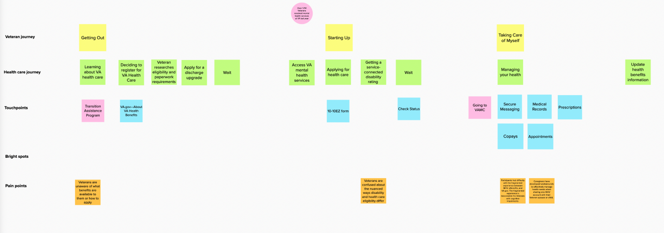
We started an experience map skeleton
C
User Story: Draft current Experience Map (skeleton)
Experience map - draft
05-17 Sprint 2 Demo
Overview

Slide 12
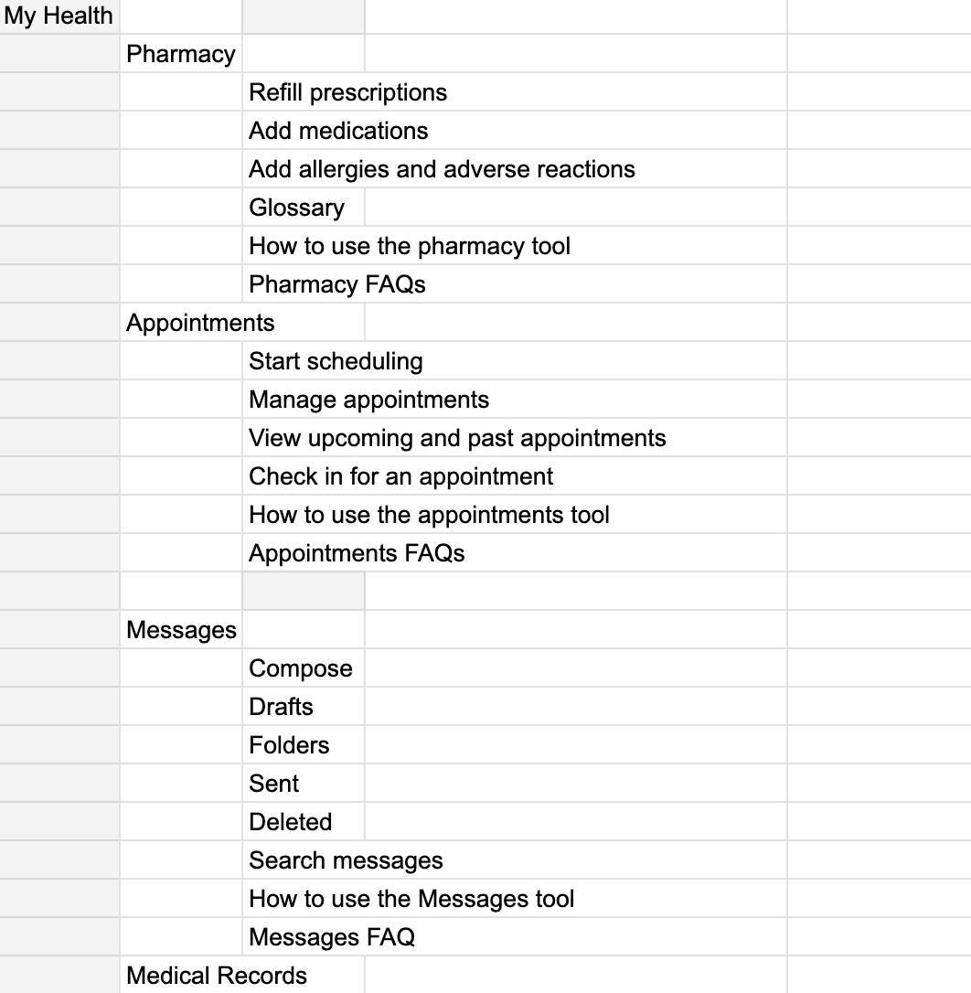
We built the tasks, trees and recruitment criteria for the IA Tree Test
D
User Story: Draft research plan (#1)
User Story: Draft task list for both hypotheses being tested (#1)
User Story: Develop IA Tree Test diagrams for both hypothesis (#1)
Task examples
You’re thinking of signing up for VA health care and you want to know what benefits you are eligible for. Where would you find information on benefit eligibility? (G)
You are caring for a Veteran whose disability status has changed (or they just got their rating). How do you find out how this impacts their benefits? (G)
You woke up with a toothache and want to see a dentist. Where would you go to find out if you qualify for dental care? (M)
You lost your job and you want to tell VA about your loss of income to see if you can pay less in copays. (M)
Research plan #1, IA Tree diagrams, recruitment
05-17 Sprint 2 Demo
Overview

Slide 13
1095-B Status Update
SPRINT 2 DEMO
05-17 Sprint 2 Demo

Slide 14

1095-B Workplan
Owned by design team
Owned by product/ engineering team
Release
WE ARE HERE
SPRINT 7
SPRINT 8
SPRINT 9
SPRINT 10
SPRINT 11
Week 14: 04/20 – 04/26
Week 15:
04-27 – 05/03
Week 16: 05/04 – 05/10
Week 17:
05/11 – 05/17
Week 18:
05/18 – 05/24
Week 19:
05/25 – 05/31
Week 20: 06/01-06/07
Week 21: 06/08-06/14
Week 22:
06/15-06/21
Week 23: 06/22-06/28
Product & Delivery
1095-B: Identify Change Management or Communications Plan
1095-B: Legal Review
1095-B: Handover plan - Prepare for launch
1095-B: Spanish translation docs
1095-B: Opt-in follow up
User Experience & Design
1095-B wayfinding
Design for opt-in
Engineering & Development
1095-B wayfinding
Collaboration Cycle
1095-B Launch
1095-B Post launch evaluation
05-17 Sprint 2 Demo
Workplan

Slide 15

We continued to monitor 1095-B developments leading to launch and post-MVP build
1
PRODUCT
User Story: PM team to f/u on VA 508 accessibility ticket
User Story: PM team to f/u on VA profile ticket for opt-in
User Story: PM team to f/u on HEC legal review - Closed 5.10.22
User Story: PM team to f/u on documents for Spanish translation
User Story: Collaboration cycle: Staging review
User Story: 1095-B Team staging review accessibility checklist
User Story: Collaboration cycle: Analytics implementation
Updates on launch and opt-in blockers:
Approved for launch (5.10.22)
VA Profile ticket transitioned to Barbara Flowers for scheduling (5.10.22)
VA 508 office had passed ticket to Mr. Sheehan for guidance (4.26.22); no reply / action 2 months
Do we just move on to VA 508 waiver request?
Awaiting Spanish translation; need clarity on if we should wait for opt-in to be built for translation - Carl (5.17.22)
508 Ticket , VA Profile opt-in ticket, 1095-B updates
05-17 Sprint 2 Demo
1095-B
15

Slide 16
Blockers for 1095-B launch
BLOCKER | OWNED BY | ACTION NEEDED | DATE ENTERED | STATUS | NOTES
Legal review | Tarsha Tremble (Business Owner) | Business Owner is seeking a POC with the Office of General Counsel to understand requirements for legal review and timeline | Sprint 3 - 3/2/22 |  | MVP is approved, opt-in is still in review
PDF Accessibility | Tarsha Tremble (Business Owner) | Team received PDF from IRS, but PDF is still not accessible once it is populated with data | Sprint 3 – 3/3/22 |  | Team is awaiting further word from 508 office
05-17 Sprint 2 Demo
1095-B Blockers

Slide 17
1095-B Remaining actions, with external dependencies
ITEM | WORK STREAM | ACTION NEEDED | TARGET COMPLETE DATE | PREREQUISITE
Launch | Product & Tech | Work with tech to create a vets-website release | End of May | None
UAT | Product & Tech | Follow Collaboration Cycle guidelines for UAT Identify Veterans within VA to conduct UAT, send access, and follow up to ensure testing complete | TBD | Product dark launched
1095-B Opt-in | Product | Follow up with HEC and Profiles team to ensure opt-in is done Update draft communications and announcement plans, based on when opt-in will be launched | April - May | HEC and Profiles commitment to building opt-in
Legal Review | Product | Work with Tarsha to complete legal review for Opt-In | March – May | POC name from Tarsha
Post Launch Check- In | Product | Complete Collaboration Cycle milestone to KPIs post launch | TBD (One month after launch and announcement) | Product launched in prod
Links from VA.gov pages to 1095-B | Product & Design | Work with IA team to have other identified pages within VA.gov (e.g., ACA page) link to the 1095-B page Work with IA team to have 1095-B page added to navigation and be found in VA.gov search | May or later | Product launched in prod; aligned on comm plan with Tarsha, Tracey
1095-B update strategy | Product | Align on who will own 1095-B long term, including updating the PDF template each year | May or later | Product complete and launched in production
Communications to announce launch | Product & Design | Work with Tarsha and HEC team to refine drafted communications and align on plan and timeline to announce 1095-B launch to Veterans Work with VA Notify team to build and launch communications on their platform | October - December | Product launched in prod; aligned on communication plan with Tarsha/Tracey
05-17 Sprint 2 Demo
1095-B Remaining actions

Slide 18
Sprint Deliverables
SPRINT 2 DEMO
05-17 Sprint 2 Demo

Slide 19
Sprint 2 Deliverables – Health Hub
EPIC | STORY | ESTIMATE | ASSIGNED | OUTPUT | REVIEWED W/ VA-PO | SPRINT TEAM GOAL COMPLETED?
Research | #40688 Draft Research Activities Plan (d-Rap) | 3 | Thomas | Research activities plan | 5/17/22 | ✓
Research | #40903 Draft research plan (#1) | 8 | Thomas | Research plan (#1) Recruitment by cohort | 5/13/22 | ✓
Research | #40904 Draft Task list for both hypotheses being tested (#1) | 5 | Thomas Carl | Research plan (#1) | 5/13/22 | ✓
Research | #40905 Develop IA Tree Test diagrams (#1) | 8 | Thomas | IA Tree (H0, H1) | 5/13/22 | ✓
Research | #40901 Draft current Experience Map (skeleton) | 5 | Shashank | Demo deck p. 11 | 5/17/22 | ✓
Research | #40610 Conduct business partner discovery, part 2 | 5 | Carolyn | Samara Strauss Mikki Northius Beth Potts Jeff Barnes | 5/12/22 | ✓
Research | #40906 Synthesize business partner discovery (round 1 & 2) | 8 | Carolyn | Bus partner discovery synthesis | 5/17/22 | ✓
05-17 Sprint 2 Demo
Sprint 2 Deliverables

Slide 20
Sprint 2 Deliverables – 1095-B
EPIC | STORY | ESTIMATE | ASSIGNED | OUTPUT | REVIEWED W/ VA-PO | SPRINT TEAM GOAL COMPLETED?
Product | #40455 PM team to f/u on HEC legal review | 0 | Tami | 1095-B updates | 5/17/22 | ✓
Product | #40454 PM to f/u w/ VA-PO on HEC documents being translated into Spanish | 0 | Tami | 1095-B updates | 5/17/22 | ✓
Product | #39723 PM team to f/u on VA Notify ticket for opt-in | 1 | Tami | #CMDMRP-2269 1095-B updates | 5/17/22 | ✓
Product | #39722 PM to f/u on VA 508 accessibility support ticket | 1 | Tami | YourIT # RITM6608047 1095-B updates | 5/17/22 | ✓
Product | #38351 Collaboration cycle: Staging review [1095-B] | 0 | Jordan | Ticket | 5/17/22 | ✓
Tech | #36175 Collaboration cycle: Analytics implementation [1095-B] | 0 | Teagan Shashank | Ticket | 5/17/22 | ✓
Tech | #38387 1095-B Team staging review accessibility checklist | 0 | Teagan Shashank | Ticket | 5/17/22 | ✓
05-17 Sprint 2 Demo
Sprint 2 Deliverables

Slide 21
Preview of Sprint 3
SPRINT 2 DEMO
05-17 Sprint 2 Demo

Slide 22
Sprint 3 of Health Hub will focus on
 | Next sprint demo: May 31st
HEALTH HUB
*Stories subject to change during Sprint planning
Finalize research plan
Prepare and execute IA tree test
Iterate experience map
Preparations for future research
1095-B
Dark launch of 1095-B
UAT
05-17 Sprint 2 Demo
Preview of Sprint 2 – Health Hub

Slide 23
Appendix
SPRINT 2 DEMO
05-17 Sprint 2 Demo

Slide 24
Project risks and mitigation strategies (1 of 2)
RISK AND IMPACT | MITIGATION STRATEGY | DATE |  | STATUS | NOTES
 |  | ENTERED | CLOSED
IRS stakeholder is outside of VA ecosystem. Building without guidance or legal review regarding compliance with IRS regulation could result in risk. | Conduct research on available information surrounding current IRS 1095-B tax form regulations. Seek legal review through VA resources as directed by VA-PO and Business Owner | 1/20/22 | 2/11/22 |  | VA Business Owner clarified that IRS review is not needed
Team had previously confirmed with Business Owner that legal review was not needed. Business Owner clarified that legal review would be needed as of March 2nd | Business Owner is seeking a POC with the Office of General Counsel to understand what is needed and potential launch impact | 3/2/22 |  |  | Launch blocker
Data requires storage in a S3 bucket that the enrollment system can have access to in production; process to create the staging and production bucket does not have a clear timeline. Without the S3 bucket in prod with enrollment system access, product cannot be built in prod | Daily follow-ups with Jesse House and Mike Chelan (infrastructure team) | 3/1/22 | 3/24/22 |  | S3 bucket now in place. Risk resolved.
Business owner raised User Acceptance Testing should be done with HEC Call Center | Requested Business Owner to schedule UAT with required individuals for mid-March and book as early as possible | 3/2/22 | 3/25/22 |  | Business owner confirmed that UAT can be done through Collaboration Cycle and does not have to be done with HEC team
Feedback from Content and IA Review has taken over a week to come in; feedback is changing our proposal for the H1 and delaying confirmation of where the 1095-B landing page should live, which in turn delays our ability to complete the front end (top nav and side nav bars) | Design team pushing on IA team to confirm final answer of where 1095-B landing page should live and what the H1 header title should be | 03/04/22 | 3/8/22 |  | URL confirmed 3/7 EOD; IA review now closed
Designs were approved as part of Midpoint Review. Afterwards, Sitewide Content stated they would need to build our front end in Drupal and change our designs, impacting our in-flight build. | Design team met with Sitewide Content to align on redesigned front end. Tech working with Sitewide Content to send over our dynamic widget to be pulled into their static front end. Sitewide Content now owns the front end build. | 3/10/22 |  |  | Launch date dependent on Sitewide Content ability to launch front end

Slide 25
Project risks and mitigation strategies (2 of 2)
RISK AND IMPACT | MITIGATION STRATEGY | DATE |  | STATUS | NOTES
 |  | ENTERED | CLOSED
HH Tree Test design held up due to new information from Meg, Danielle and Mikki. | VA and MO team could work in collaborative sessions so that work is not duplicated and we can arrive at a test design that works by the end of Sprint 3 | 5/16/22 |  |  | Awaiting version of ‘manage’ tree that we can incorporate into research trees in order to move forward with research plan
05-17 Sprint 2 Demo
Appendix

Slide 26
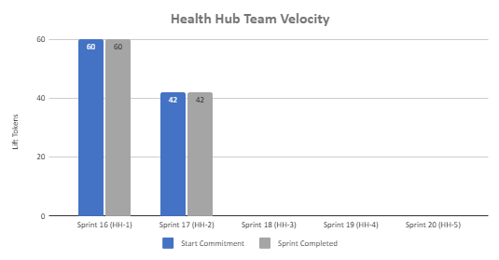
Health Hub Team velocity
 | Velocity details Velocity estimated in story points, using Fibonacci Velocity in Sprint 2 accounted for 7 team members; one less than prior sprint 42 total story points were completed; Team committed to 42 story points at beginning of the sprint. 7 Stories represent 1095-B work (0 points) and remain stalled related to HEC legal review, Spanish translation, Opt-in function request, and VA 508 office assistance request
05-17 Sprint 2 Demo
Appendix
26

Slide 28
A
Lorem
User Story: Lorem
User Story: Lorem
User Story: Lorem
User Story: Lorem
User Story: Lorem
Lorem
Lorem
Lorem
Lorem
Lorem
Lorem
Lorem
Link
05-03 Sprint 1 Demo
Tech
28

Slide 29
2
DESIGN
Lorem
User Story: Lorem
User Story: Lorem
Lorem
Lorem
Link
05-03 Sprint 1 Demo
Design
29

Slide 30
2
DESIGN
Lorem
User Story: Lorem
User Story: Lorem
Lorem
Lorem
Link
05-03 Sprint 1 Demo
Design
30

Slide 31
3
PRODUCT
Lorem
User Story: Lorem
User Story: Lorem
Lorem
Lorem
Link
05-03 Sprint 1 Demo
Product
31

Slide 32
1
TECH
Lorem
User Story: Lorem
User Story: Lorem
User Story: Lorem
User Story: Lorem
User Story: Lorem
Lorem
Lorem
Lorem
Lorem
Lorem
Lorem
Lorem
Link
05-03 Sprint 1 Demo
Tech
32

Slide 33
2
DESIGN
Lorem
User Story: Lorem
User Story: Lorem
Lorem
Lorem
Link
05-03 Sprint 1 Demo
Design
33

Slide 34
2
DESIGN
Lorem
User Story: Lorem
User Story: Lorem
Lorem
Lorem
Link
05-03 Sprint 1 Demo
Design
34

Slide 35
3
PRODUCT
Lorem
User Story: Lorem
User Story: Lorem
Lorem
Lorem
Link
05-03 Sprint 1 Demo
Product
35

Slide 36
Sprint 1 will run April 20 to May 3rd
Owned by design team
Owned by product/ engineering team
Release
WE ARE HERE
SPRINT 1
SPRINT 2
SPRINT 3
SPRINT 4
SPRINT 5
Week 1: 04/20 – 04/26
Week 2: 04/27 – 05/03
Week 3: 05/04 – 05/10
Week 4: 05/11- 05/17
Week 5: 05/18 – 05/24
Week 6: 05/25 – 05/31
Week 7: 06/01 – 06/07
Week 8:
06/08 – 06/14
Week 9: 06/15-06/21
Week 10: 06/22-06/28
Product & Delivery
1095-B: Identify Change Management or Communications Plan
1095-B: Legal Review
1095-B: Handover plan - Prepare for launch
1095-B: Opt-in follow up
1095-B: Spanish translation docs
HH: Charter
HH: Develop backlog + Vision Framework
HH: Roadmap
User Experience & Design
1095-B: Wayfinding plan
Testing prep & recruiting
Voice of Veteran
Voice of Veteran
HH: Discovery
HH: Stakeholder Interviews
HH: Current State Journey Map
Prioritized plan
Engineering & Development
HH: Tech discovery
HH: Stakeholder Interviews
HH: Proposed tech integrations based off research findings
Collaboration Cycle
Midpoint Review
1095-B: Launch Date Dependent on Legal Review Completion
Research Plan Review
Research Plan Review
*Does not show post-MVP Validate phase meetings in Collaboration Cycle, such as Full Accessibility Audit and Post-Launch Check In; Contact Center Review adjusted to 3 weeks before launch as approved by Jason Woodman
Preview of Sprint 7

